Slide 1

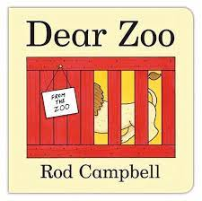



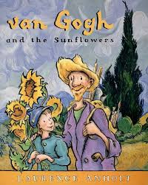

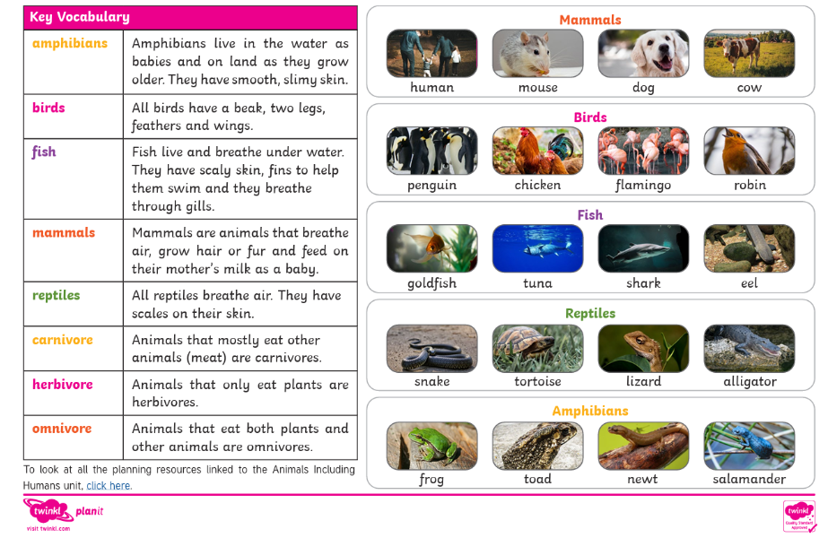
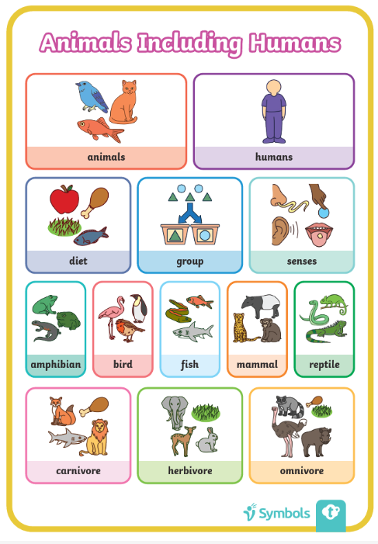
Summer: Knowledge Organiser
Key books this term
Dear Zoo– Week 2
Oliver’s Vegetables / Van Goug’s Sunflowers - Week 1
Animals all over the world- Week 4
Trip to the Wild Place – Week 5
Rumble in the Jungle- Week 3

Slide 2
