Slide 1


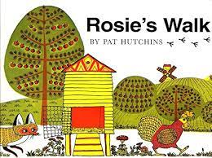
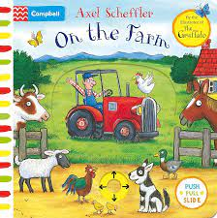












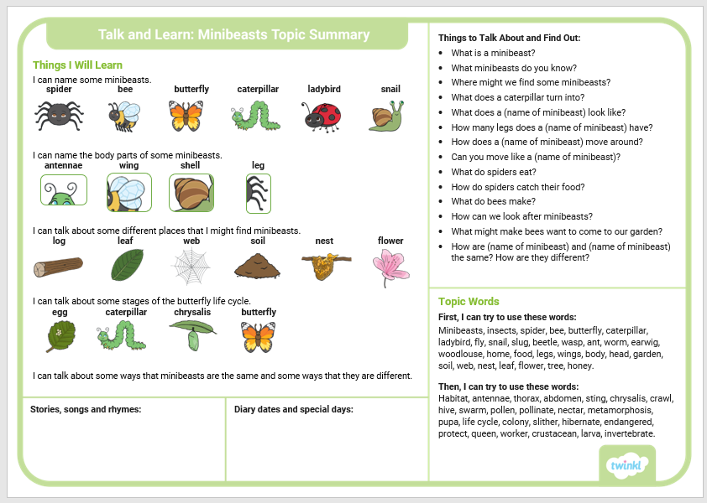
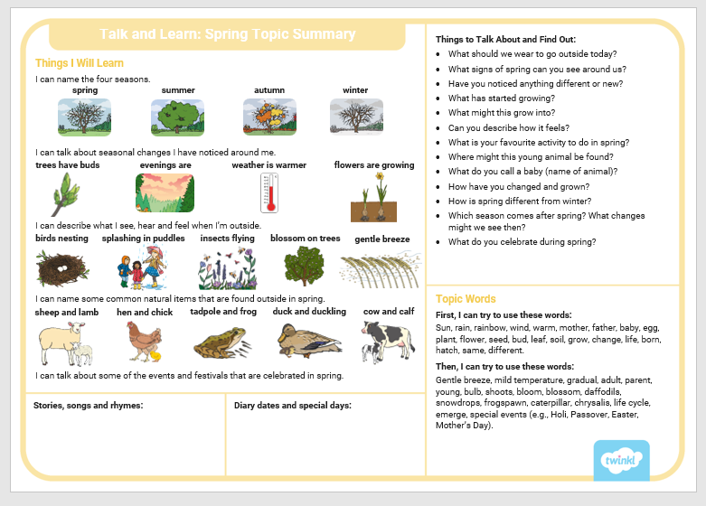
Spring 2: Knowledge Organiser
Key books this term
The Very Hungry Cterpillar– Week 2
Minibeasts - Week 3 + 4
Life on the Farm - Week 5
Easter
Spring- Week 1

Slide 2
