Slide 1





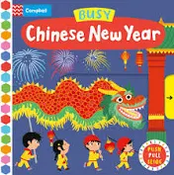



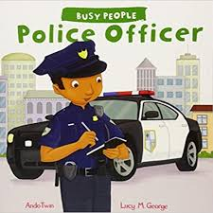
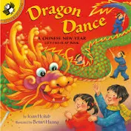



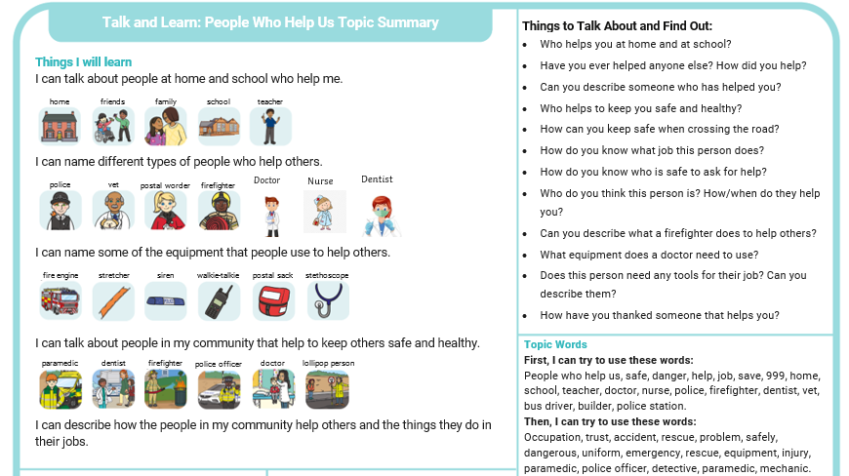
Spring 1: Knowledge organiser
Key books this term
Chinese New Year week 3
Doctors, Nurses and Dentists week 1- 2
Firefighters week 4
Police week 5
Other Occupations - week 6

Slide 2




Physical Development
Mathematics
We follow the white rose scheme for maths, incorporating Numicon and number blocks to support our math's learning.
Knowledge and understanding of the world
Fine motor:
Name writing
The children will continue to practice writing their names, following the arrows to ensure they start their letters in the correct place and have the correct formation.
Funky Fingers
      The children will have activities on their table that will focus on their fine motor skills. Examples of this: Playdoh, threading, drawing, stencils, scissor skills and games. These fine motor skills help the children to develop their hand muscles and support their pencil formation.
Numbers
We will continue to learn our numbers and represent them in different ways. Using objects, ten frames and number lines. We will play games that involve counting and numbers.
People and their communities
We will look at people who help us and
talk about their jobs.
We will focus on Doctors,
Nurses, Fire fighters, police, dentists, piolets
We will also be celebrating
Chinese New Year, trying
Chinese food and completing
craft.
Composition of 5
We will be finding different ways to make 5.
Patterns:
Odd one out
We will continue to explore patterns and concepts behind patterns
We will make patterns and look at patterns in numbers..
Self care
Encourage your children to dress themselves – doing up coats, zips, buttons, shoes.
Eating – using cutlery, opening lunch boxes and food bags. Hygiene – cleaning teeth, brushing hair, toileting.
In play
In play the children will improve their fine motor skills they will do this whilst using construction, dressing dolls, threading and a range of other activities that will be out in provision.
Capacity and measuring
We will explore measuring in lots of different ways.
AT HOME: Pencil grips- We will be teaching the children to write using a tripod grip- please encourage this at home. Encourage the children to be independent as possible. Try to use cutlery and eat independently.
Gross motor
Children use their gross motor skills to perform every day functions, such as walking and running, playground skills (e.g. climbing) and sporting skills (e.g. catching, throwing and hitting a ball with a bat). We will practice these skills during PE sessions and in the outside area.
  AT HOME: Practice counting and looking for numbers in the world around them.
Past and Present
We will look at how jobs have changed over the years.
  Jigsaw
  Dreams and Goals
Literacy- Reading and writing
Expressive arts and design
Phonics
This year we be using a phonics scheme called ‘Little Wandle Letters and Sounds’. The big focus is to help the children to be able to read by Christmas. We will teach the children key skills over the Autumn term to help them to achieve this.
Role play we will be acting different roles.
We will also use boxes and loose parts to make up own imaginative play.
  AT HOME: Talk to your children about different jobs in the community.
Oral blending
Blending in phonics is combining broken up sounds to make a word.
For example, you hear ‘p-i-g’ and you merge these sounds together to make the single word ‘pig’. It is a key skill of early reading.
Sounds
  We will be learning these sounds (phonemes) for each of the letter of the alphabet, linking each sound to its letter (grapheme).
  We will also be learning the capital letter than corresponds with the sound.
  This will be supported by learning a handwriting rhyme for each letter to help with letter formation.
Consider the listener and takes turns to listen and speak in different contexts.
Can identify kindness and considerate behaviour of others.
  AT HOME: Practice blending and segmenting.
Art
Artist Yves Klein
Hearts
Take pride in themselves, work, and achievements.
Can explain right from wrong and try to behave accordingly.
Construction
The children have access to a range of constructional resources in the classroom. Including loose parts and our DT area.
Segmenting
This is the process of breaking down the words into separate sounds and syllables. For example ro-bot.
Tricky words: These are words that you cannot sound out, they have a tricky part- for example: said. The tricky part is the ‘ai’ making the ‘e’ sound.
Extras:
*Visit from People Who Help us
Topics
Week 1and 2 – Dentist Doctors and Nurses
Wekk 3 – Chinese New Year
Week 4 Fire Fighters
Week 5 Police
Week 6 Other jobs
  AT HOME:Please practise the sound cards and .tricky words at home with your children.
  We will begin to read and write simple words with the sounds that we learn. For example sat, at, pin, pip, pan, sad, mat. The children will do this on whiteboards on the carpet, during phonics and literacy session and have opportunities during choosing time.
Music We will continue to use the musical instruments to tap out tunes and beats to a song and sing along . We will also enjoy a music session with Piano Pete.
  AT HOME: Talk to your children about ways we can be a really good friend.
  AT HOME: Try and tap out a beat to a favourite song. .

